Slide 1
Music Genre Recognition from Audio Tracks and Metadata
Rock Music Detected!
CS464 Group 9 Project Final Presentation
Can Kocagil, Berkay Erkan, Efe Eren Ceyani, Mehmet Calıskan, Hammad Khan Musakhel

Slide 2

Plan of Attack
What is Music Genre Recognition?
The Dataset
Metadata-level Computing
Metadata Level Analysis
Metadata Manifold Learning
Machine Learning for Metadata
Meta Learning for Metadata
Model Explainability
Audio-level Computing
Audio Level Signal Analysis
Mel Spectrum Computing
2-D CNNs for Spectrums
Vision Transformer for Spectrums

Slide 3
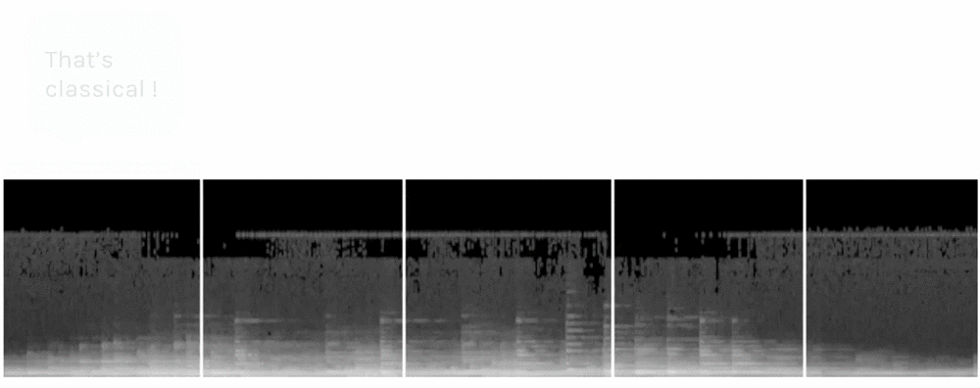
What is Music Genre Recognition?
Automatic recognition of audio tracks from music waves has been a challenging task in Music Information Retrieval (MIR).
The mathematical representation of natural music, composed of rhythm, tones, intervals, patterns, and harmonies, is a complex subject for human specialists as there is a geometric interpretation in the humming of the strings and inherent subjective nature.

Slide 4
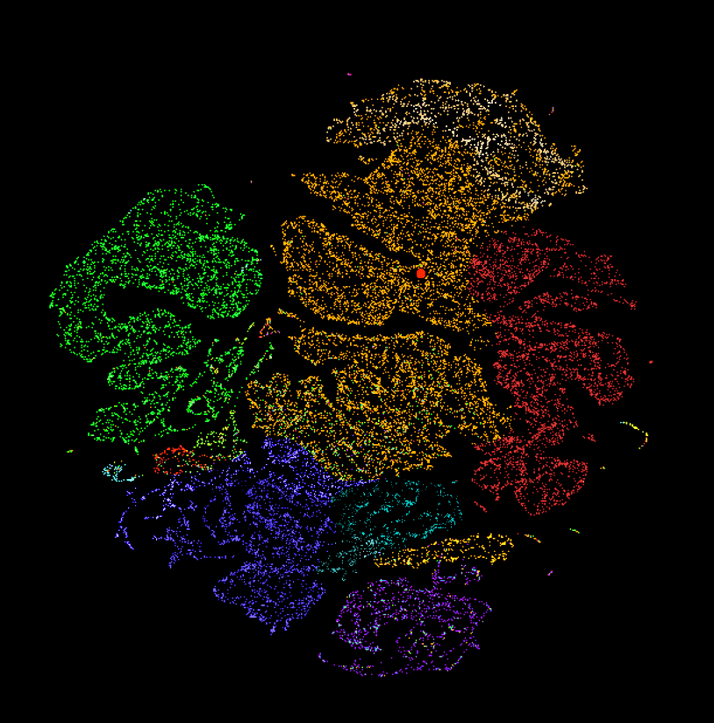
The Dataset
As the dynamics of common genres are temporally varied, representable and scalable datasets are required to perform cognitive tasks in Music Information Retrieval (MIR).
The Free Music Archive (FMA) [1] is a dataset for everyday MIR analysis tasks and is supervised for browsing, searching, and organizing extensive music collections. The FMA dataset is a MIR benchmark dataset that consists of 106,574 tracks from 16,341 artists and 14,854 albums, arranged in a hierarchical taxonomy of 161 genres
Class Names
'Pop'
'Folk'
'Rock'
'Hop'
'Experimental'
'International'
'Electronic'
'Instrumental'

Slide 5
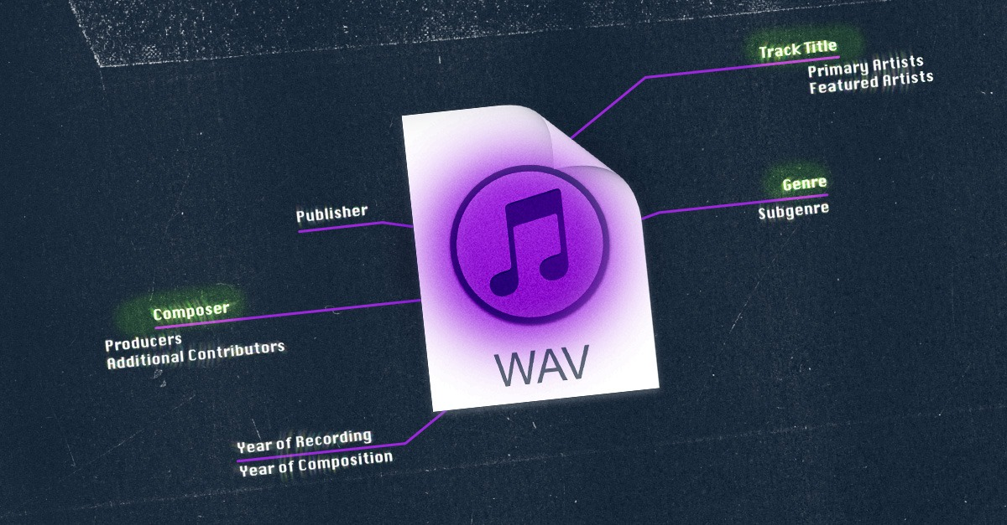
Metadata-level Computing
Metadata Level Analysis
Metadata Manifold Learning
Machine Learning for Metadata
Meta Learning for Metadata
Model Explainability

Slide 6
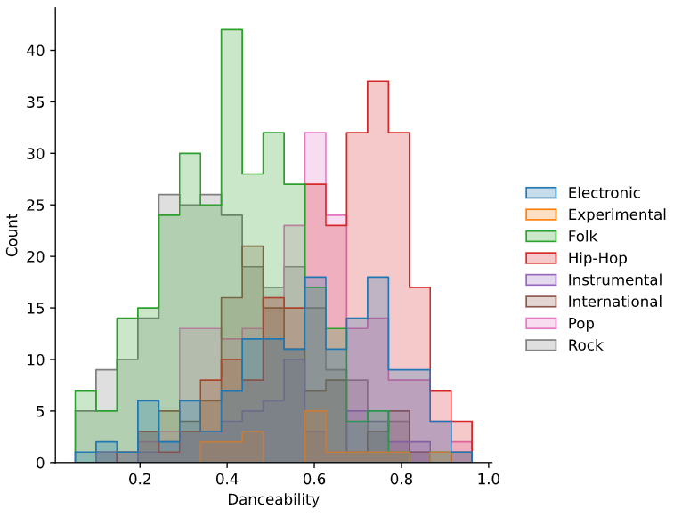
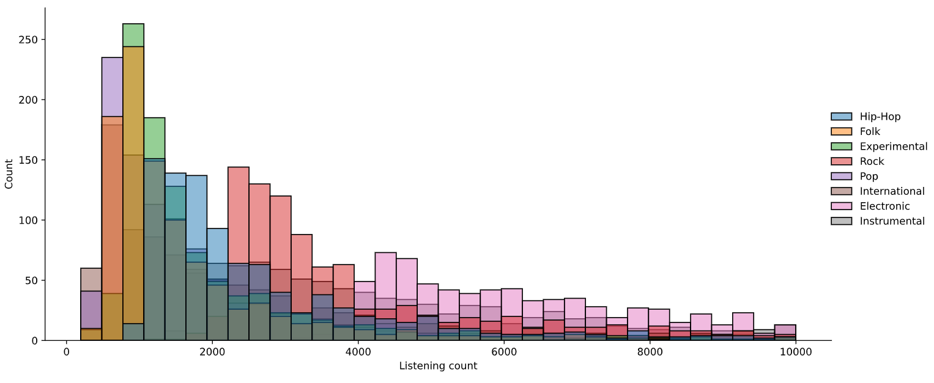
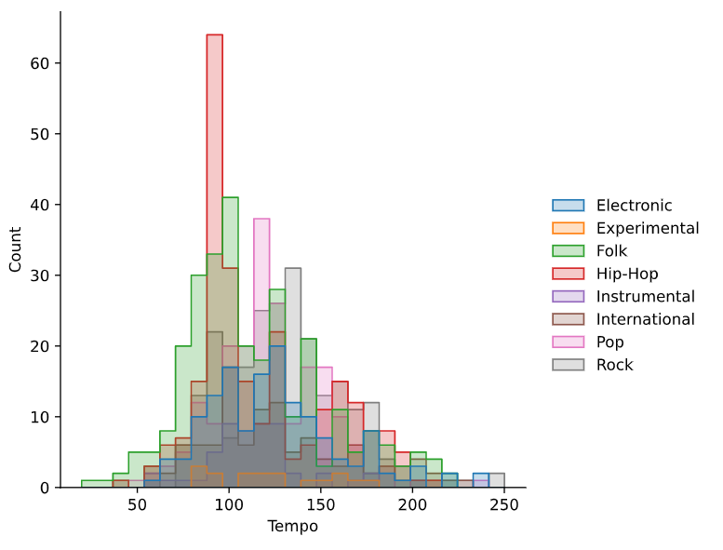
Metadata Level Analysis

Slide 7
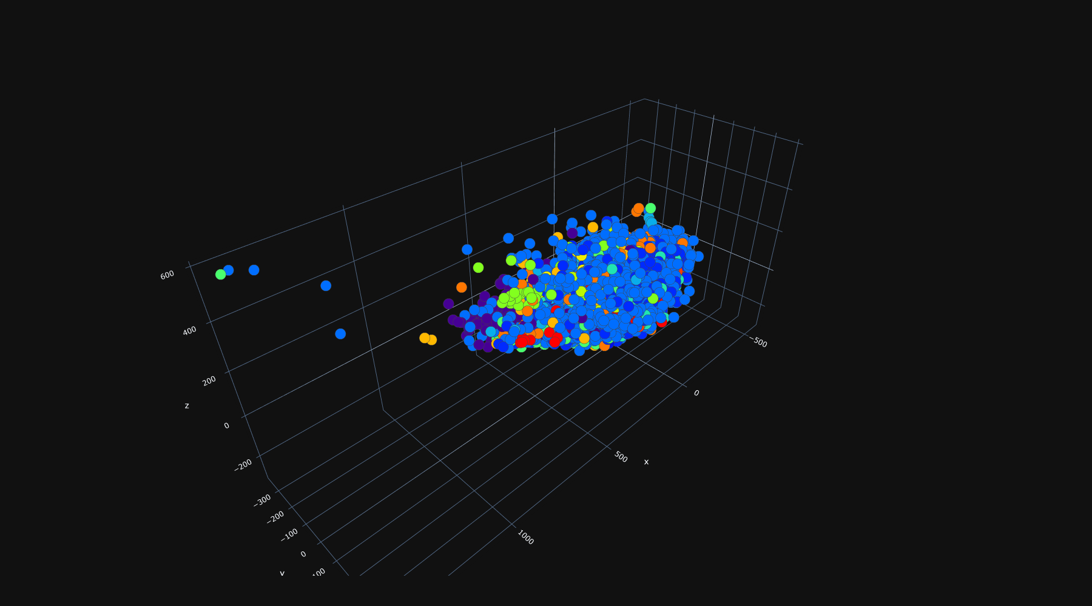
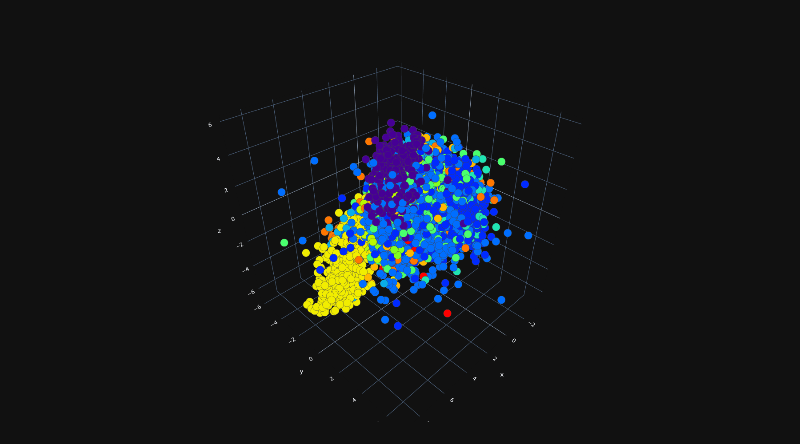
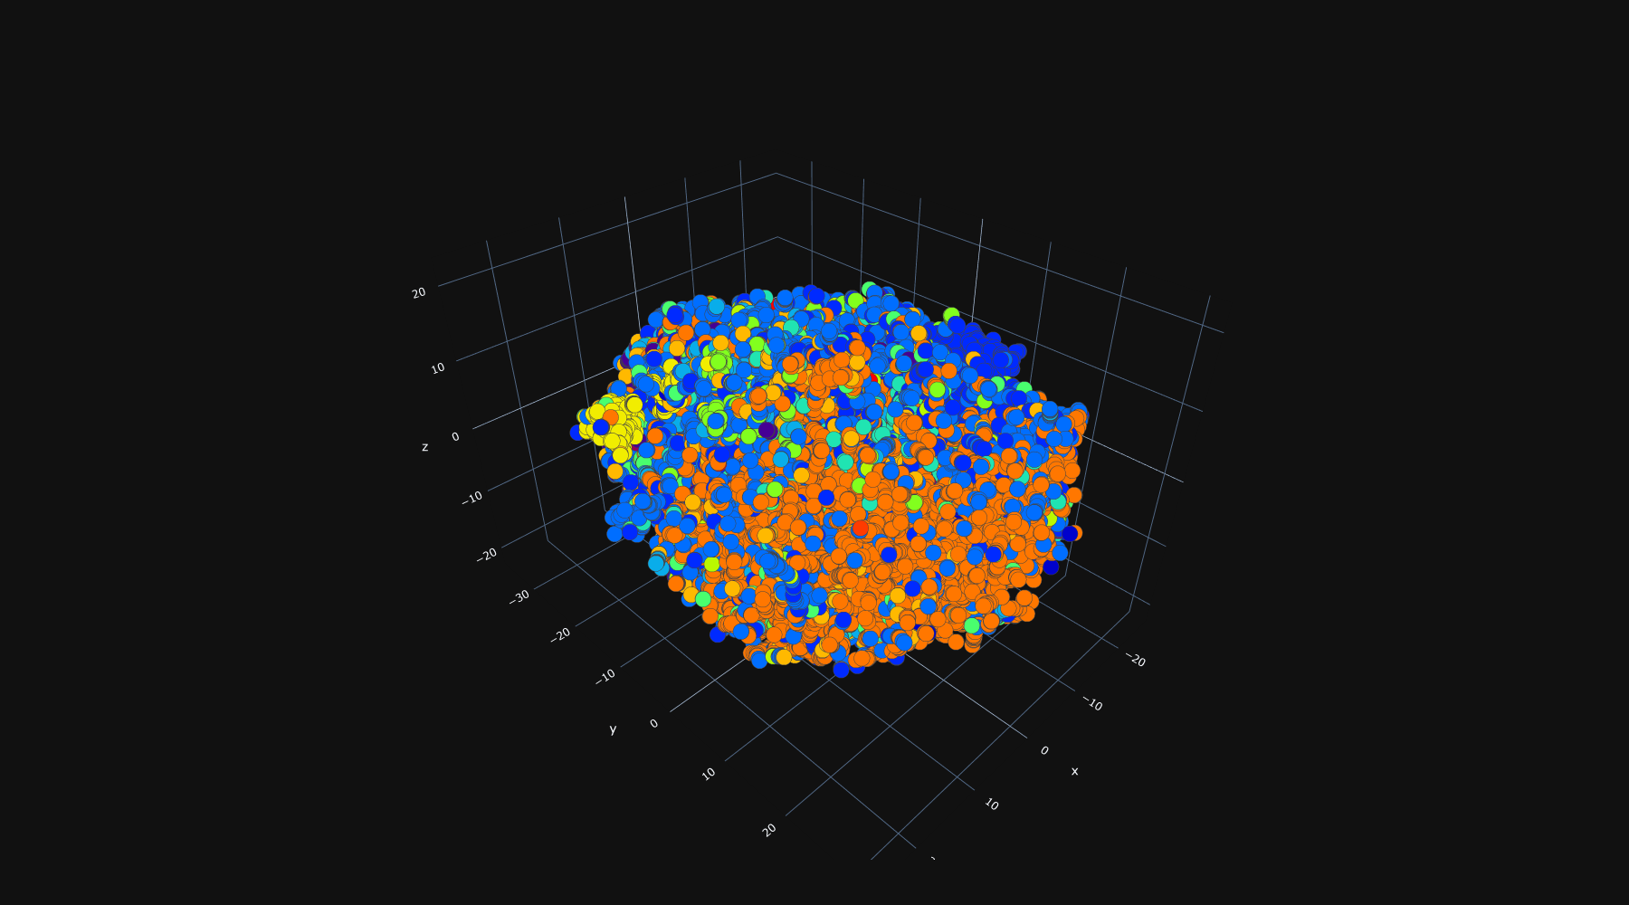
Metadata Manifold Learning
3-D PCA Projection of Metadata
3-D LDA Projection of Metadata
3-D t-SNE Projection of Metadata

Slide 8
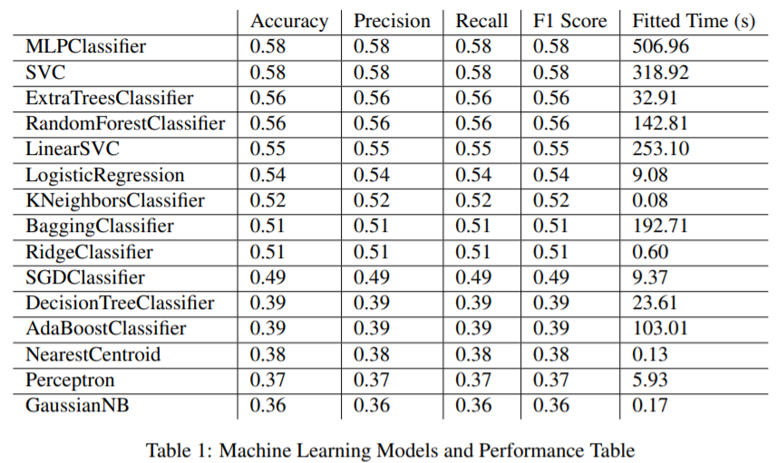
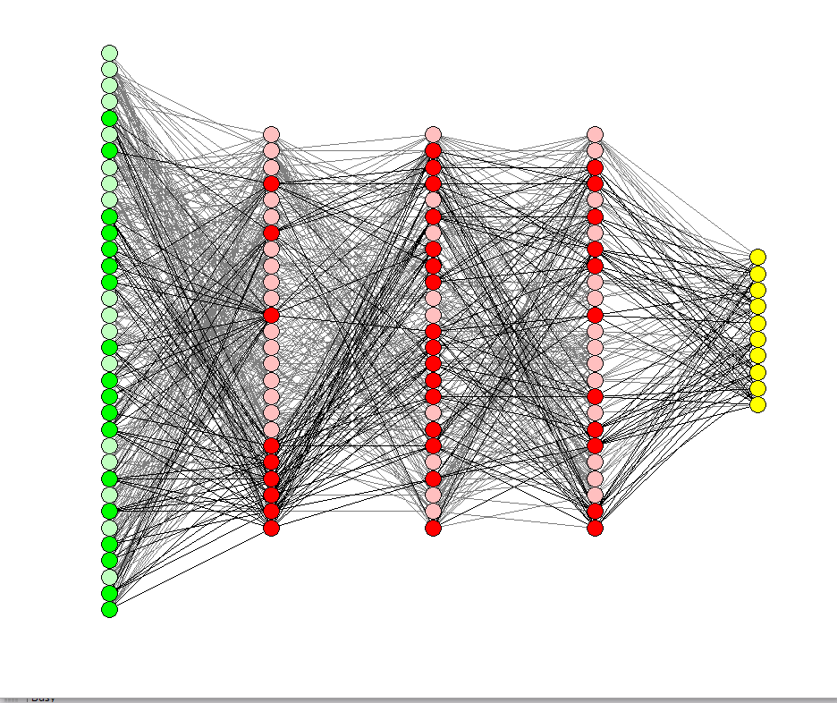
Machine & Ensemble Learning for Metadata
Around 55-58% Metadata-level Accuracy
MLP is winner!

Slide 9
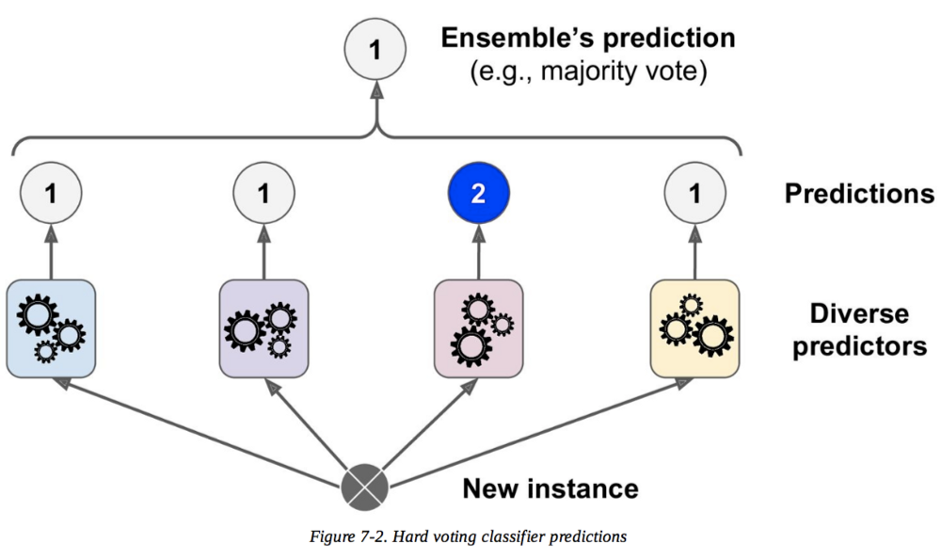
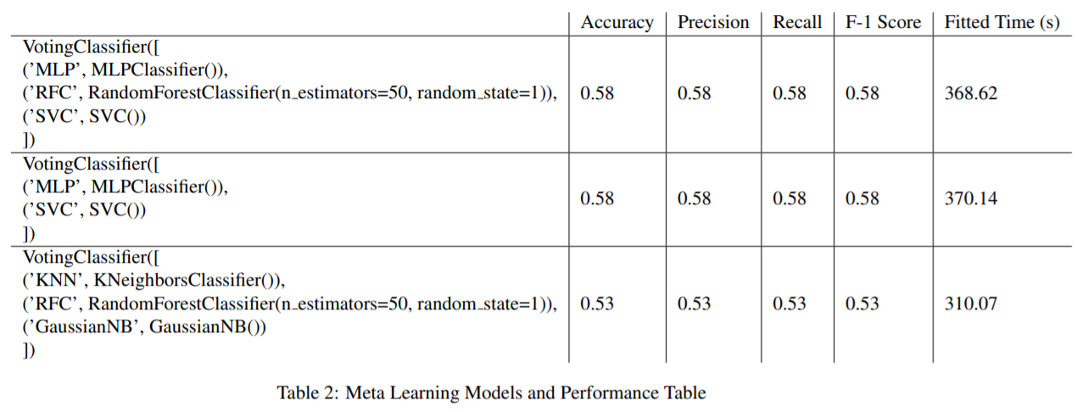
Meta Learning for Metadata

Slide 10
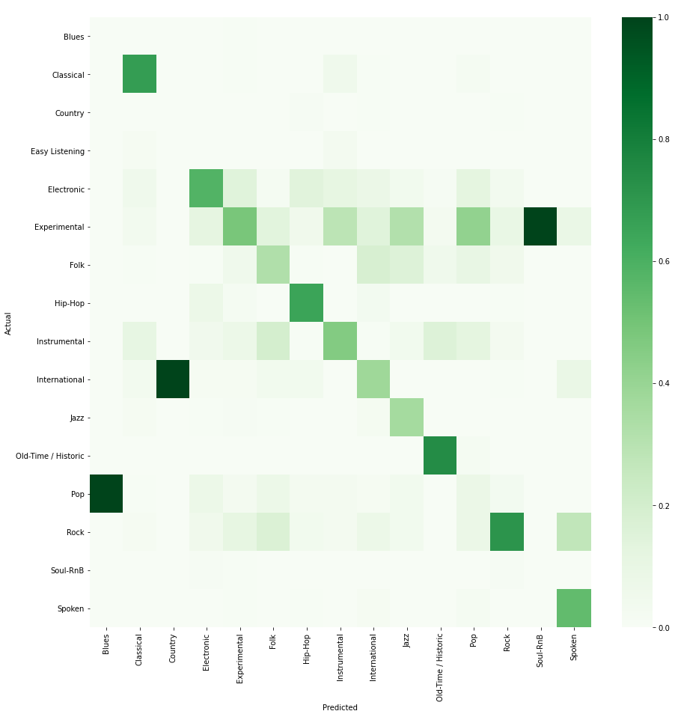
Confusion Matrix

Slide 11
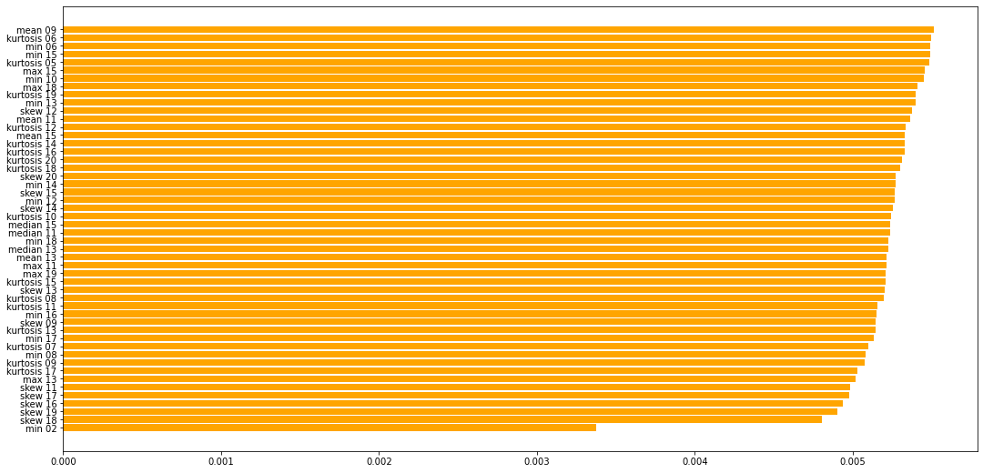
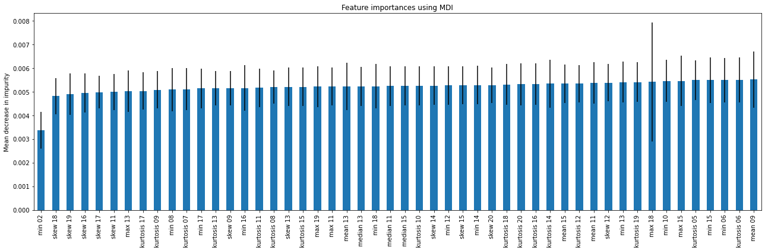
Model Explainability
Random Forest is used for explainability purposes

Slide 12
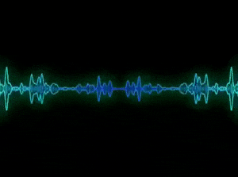
Audio-level Computing
Audio Level Signal Analysis
Mel Spectrum Computing
2-D CNNs for Spectrums
Vision Transformer for Spectrums

Slide 13
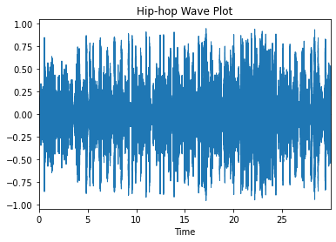
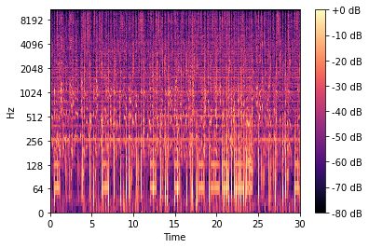
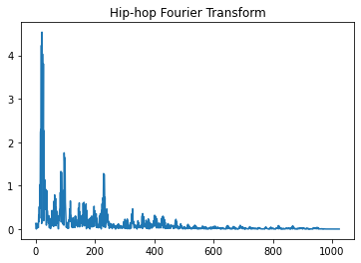
Audio Level Signal Analysis

Slide 14
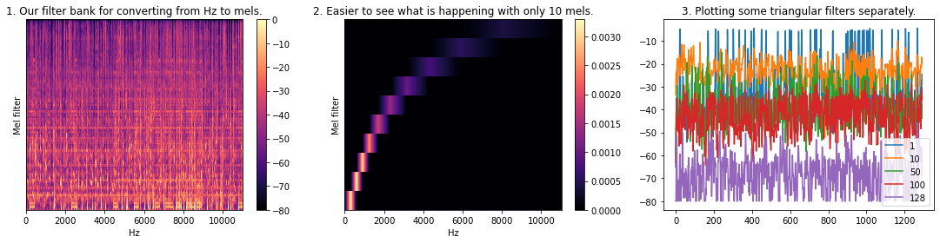
Audio Level Signal Analysis
It partitions the Hz scale into bins, and transforms each bin into a corresponding bin in the Mel Scale, using overlapping triangular filters

Slide 15
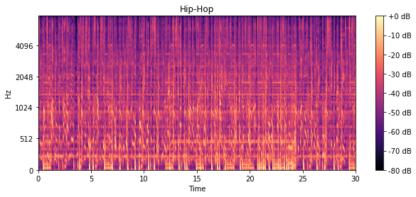
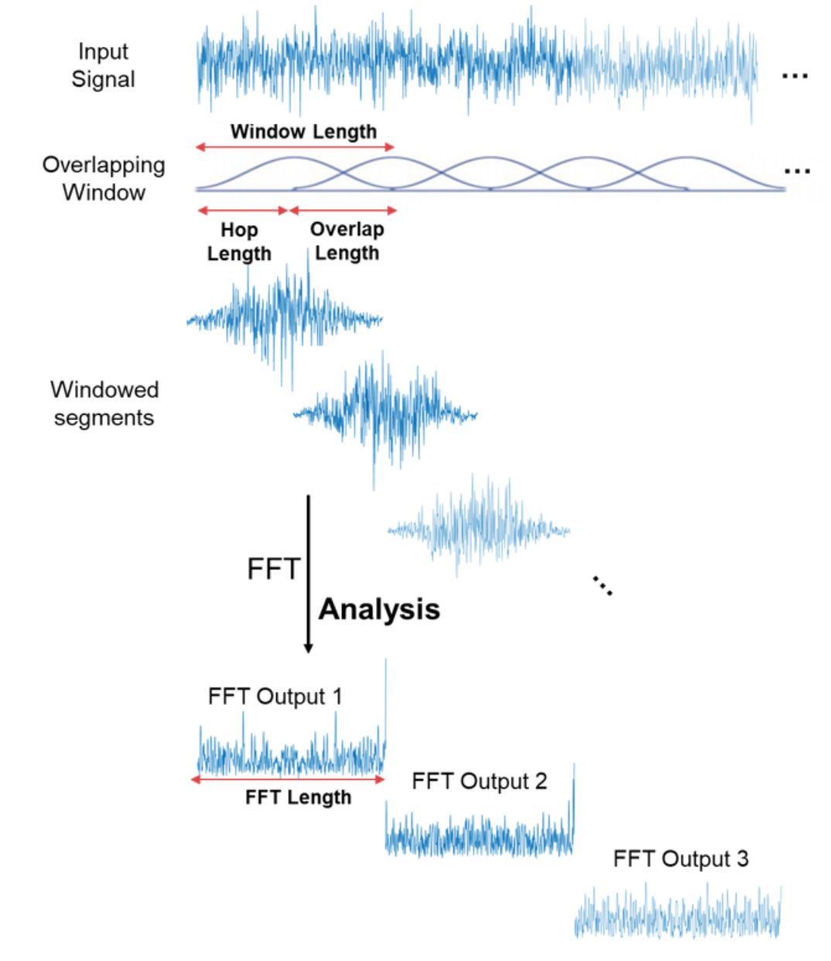
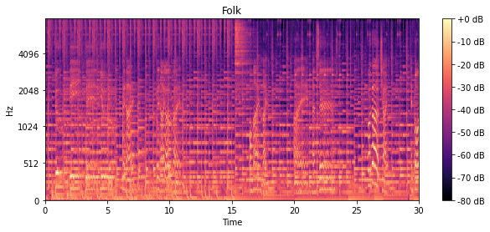
Mel Spectrum Computing

Slide 16
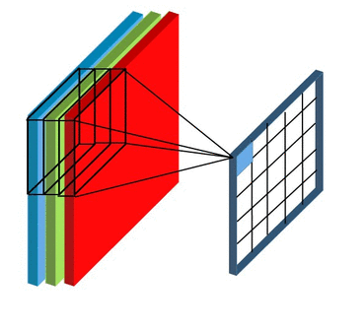
2-D CNNs for Spectrums
Naive CNN
Deeper architecture is utilized but for the visualization purposes we keep it simple.

Slide 17
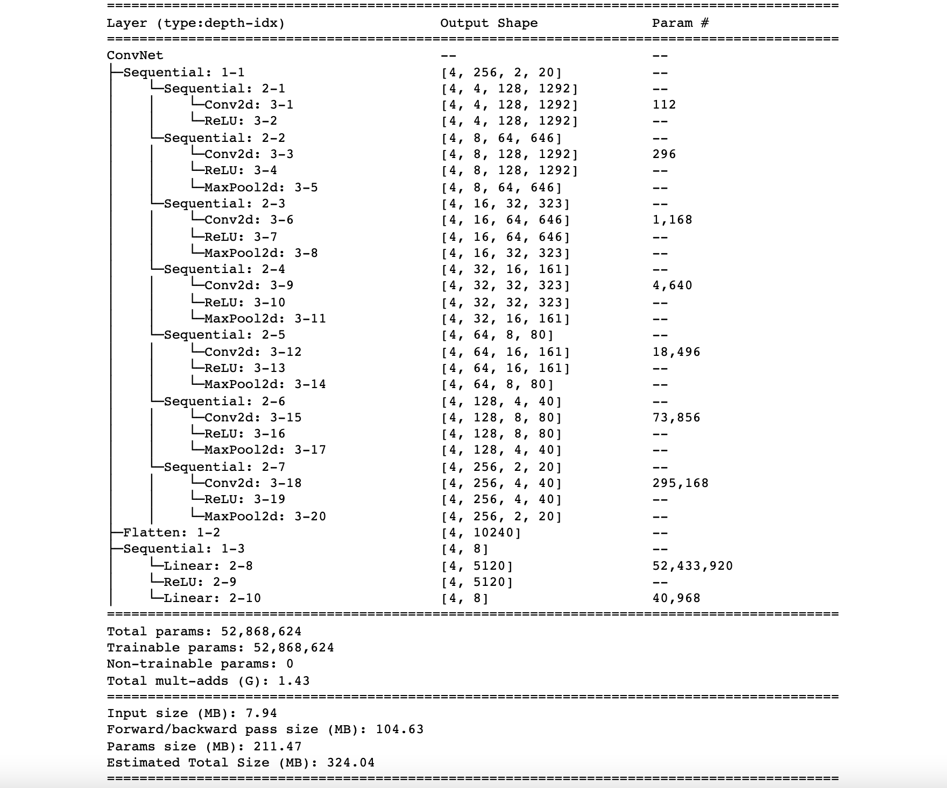
2-D CNNs for Spectrums
The Complete Architecture

Slide 18
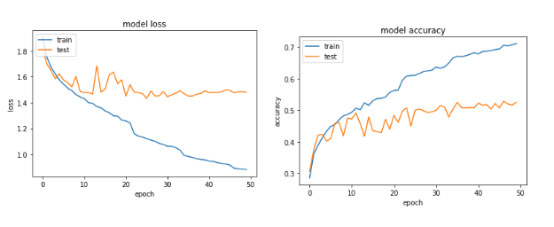
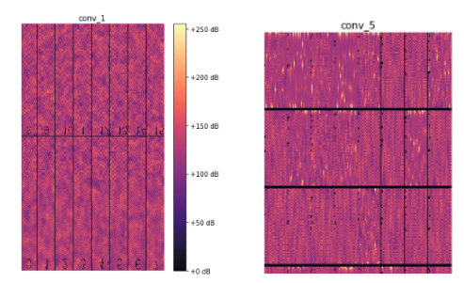
2-D CNNs for Spectrums
Accuracy 51%
To understand what the filter is focusing on, we look at what kind of input maximizes the activations in that filter. Figure below shows the filter activations of all 16 filters in the first convolution blocks vs the first 24 filters of the fifth convolution block

Slide 19
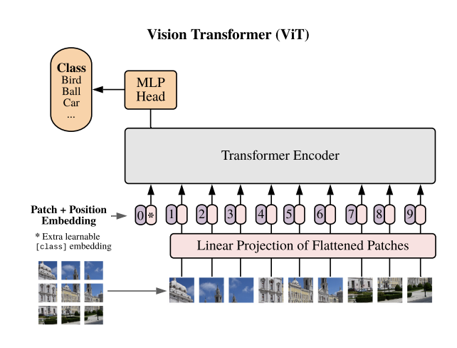
Vision Transformer for Spectrums
The Vision Transformer, or ViT, is a model for image classification that employs a Transformer-like architecture over patches of the image. An image is split into fixed-size patches, each of them are then linearly embedded, position embeddings are added, and the resulting sequence of vectors is fed to a standard Transformer encoder. In order to perform classification, the standard approach of adding an extra learnable “classification token” to the sequence is used

Slide 20
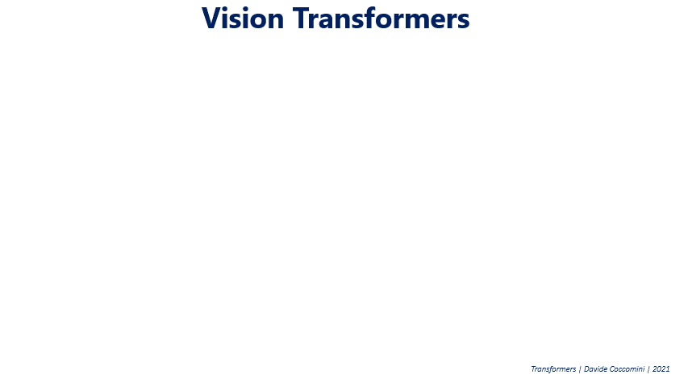
Vision Transformer for Spectrums
Accuracy around 42%

Slide 21
Questions

